Slide 1
Relational Calculus
Chapter 8 of textbook
CS3319

Slide 2
Relational Calculus
2 Types: Tuple Relational Calculus that ranges over tuples and Domain Relational Calculus uses domain variables
The query is specified in a single declarative statement, without specifying any order or method for retrieval, thus it is a non procedural language
Expressive power is identical to relational algebra (it can state all the same queries)
CS3319

Slide 3
We will be using the following tables for our discussion and examples:
Employee
FName | Minit | Lname | SSN | BDate | Address | Sex | Salary | SuperSSN | DNO
Department
DName | DNumber | MGRSSN | MgrStartDate
Works_On
ESSN | PNO | Hours
Project
PName | PNumber | Plocation | DNum
Dependent
ESSN | DependentName | Sex | BDate | Relationship
DepartmentLocation
Dnumber | Dlocation
CS3319

Slide 4
Tuple Relational Calculus
General Form:
{t | COND(t)}
where t is a tuple variable and COND(t) is a Boolean expression involving t
COND(t) must evaluate to be TRUE for t
Example:
  To find all employees whose age is > 45, we write the following:
{t | EMPLOYEE(t) AND t.AGE > 45}
  If we only want first and last name for employees over 45 we write:
{t.Lname, t.Fname | EMPLOYEE (t) and t.AGE > 45}
CS3319

Slide 5
In general, we must specify three things:
  The range relation of t (eg. EMPLOYEE(t))
  The condition which must evaluate to TRUE
  A set of attributes to be retrieved, the requested attributes
QUESTION: Retrieve the birth date and address of the employee whose name is 'Jon Mortensen'
CS3319
Notes:
{t.birthdate, t.address | EMPLOYEE(t) AND t.lname =“Mortensen” and t.fname=“Jon”}

Slide 6
Also we need two more symbols called quantifiers: they are the universal quantifier → ∀ and the existential qualifier → ∃
With the existential quantifier, a formula:
(∃t)(F)
is TRUE if the formula F evaluates to TRUE for some (at least one) tuple.
With the universal quantifier, a formula:
(∀t)(F)
is TRUE only if the formula F evaluates to TRUE for every tuple.
CS3319

Slide 7
Tuple Calculus Examples:
Retrieve the name and address of all employees who work for the 'Research' Department
{t.Fname, t.Lname, t.Address | EMPLOYEE(t) and ((∃d) (DEPARTMENT(d) and d.Dname = 'Research' and d.Dnumber = t.dno))}
For every project located in 'London', list the project number, the controlling department number, and the department manager's last name.
{p.PNumber, p.Dnum, e.lname | PROJECT(p) and EMPLOYEE(e) and p.PLocation = 'London' and ((∃ d)(DEPARTMENT(d) and d.Dnumber = p.Dnum and d.Mgrssn = e.ssn))}
CS3319

Slide 8
Find the name of employees who have no dependents
{e.Fname, e.lname | EMPLOYEE(e) and (NOT (∃d) (DEPENDENT(d) and e.SSN = d.ESSN))}
OR
{e.Fname, e.lname | EMPLOYEE(e) and ((∀d) (NOT DEPENDENT(d)) or NOT(e.SSN = d.ESSN))
CS3319

Slide 9
QUESTION: Write the tuple relation calculus to find any employee last name who work on projects. Also list the number of hours they worked on the project and the project name:
{e.fname, w.hours, p.pname | EMPLOYEE(e) and WORKSON(w) and PROJECT(p) and p.pnumber=w.PNO and w.ESSN=e.SSN}
CS3319

Slide 10
Question: Write the query to find the names of all employees who work on all the projects controlled by department 5
{e.Firstname, e.Lastname | EMPLOYEE(e) AND ((∀x)(NOT (PROJECT(x)) or (NOT (x.DNUM = 5) or ((∃w) (WORKSON(w) and w.ESSN = e.SSN and x.PNUMBER= w.PNO)))))}
CS3319

Slide 11
Question: Write the query to find the names of all employees who work on all the projects controlled by department 5
{e.Firstname, e.Lastname | EMPLOYEE(e) AND F’}
F’ = ((∀x)(NOT (PROJECT(x)) or F1))
F1 = NOT (x.DNUM = 5) or F2
F2 = ((∃w) (WORKSON(w) and w.ESSN = e.SSN and x.PNUMBER= w.PNO))
CS3319

Slide 12
Question: Write the query to find the names of all employees who work on all the projects controlled by department 5
Using Existential quantifiers only…
{e.FNAME, e.LASTNAME | EMPLOYEE(e) AND (NOT ( ∃ x) (PROJECT(x) and (x.DNUM=5) AND (NOT (∃ w) (WORKS_ON(w) AND w.ESSN = e.SSN AND x.PNUMBER=w.PNO))))}
CS3319

Slide 13
Question: Write the query to find the names of all employees who work on all the projects controlled by department 5
“For every tuple x in the PROJECT relation”
“with x.DNUM = 5”
“there must exist a tuple w in WORKS_ON such that w.ESSN = e.SSN and w.PNO = p.PNUMBER”
==
“EMPLOYEE e works on every PROJECT X in DEPARTMENT Number 5”
CS3319

Slide 14
Similar to Division in Relational Algebra
Consider: Suppose we have an employee who doesn't work on one of the projects controlled by department 5 (Let's say there are 4 projects controlled by department 5 and he only works on 3 of them). We will look at that last project that he doesn't work on:
  x, a tuple from the project table, which is controlled by dept 5, will be in the project table so NOT(PROJECT(x)) = FALSE
  have a DNUM=5 so NOT(x.DNUM=5) = FALSE
  but there will not exist a w in the WORKSON table where w.PNO = x.PNUMBER and w.ESSN=e.SSN so that will be FALSE
  thus we have (F or F or F) = FALSE and the FORALL x is now F because there is one x that it is false for, thus it is not true for all x
{e.Firstname, e.Lastname | EMPLOYEE(e) AND ((∀x)(NOT (PROJECT(x)) or (NOT (x.DNUM = 5) or ((∃w) (WORKSON(w) and w.ESSN = e.SSN and x.PNUMBER= w.PNO)))))}
CS3319

Slide 15
2. If we assume that x is not in the PROJECT table then for all x, the predicate would be true (so display all employees since there are no projects, you could say all the employees work on all the projects controlled by dept 5 since there are 0 projects and everyone works on 0 projects), but there must be some project tuples so it is FALSE
  we will assume that x is in the PROJECT table but let’s also assume, none of the tuples = 5 then since there are no projects controlled by department 5 you could say all the employees work on all the projects controlled by dept 5 since there are 0 projects and everyone works on 0 projects), if there are some projects that are project 5, then NOT(x.DNUM=5) is false
  let’s assume that x is all the tuples that are in the project table and are 5, there must exist a corresponding workson tuple for every one of the x tuples for this to be true
{e.Firstname, e.Lastname | EMPLOYEE(e) AND ((∀x)(NOT (PROJECT(x)) or (NOT (x.DNUM = 5) or ((∃w) (WORKSON(w) and w.ESSN = e.SSN and x.PNUMBER= w.PNO)))))}
CS3319

Slide 16
Domain Relational Calculus
In Domain Calculus an expression is of the form:
{x₁, x₂, ...., x_{n}| COND(x₁, x₂, ...x_{n}, x_{n +1}, ....x_{n+m})}
  Retrieve the birth date and address of the employee whose name is 'Jon R. Mortensen' :
  {uv | (∃q)(∃r)(∃s) (EMPLOYEE(qrstuvwxyz) and q = 'Jon' and r = 'R.' and s='Mortensen')}
  or alternative notation would be:
  {uv | EMPLOYEE('Jon','R.','Mortensen', t,u,v,w,x,y,z)}
CS3319

Slide 17
Domain Calculus Examples
For every project located in 'London', list the project number, the controlling department number, and the department manager's last name.
{iks | (∃j) (PROJECT(hijk) and (∃t)(EMPLOYEE(qrstuvwxyz) and (∃b) (∃c)(DEPARTMENT(abcd) and k=b and c=t and j='London')))}
Find the name of employees who have no dependents
{qs | (∃t) (EMPLOYEE(qrstuvwxyz) and (not (∃l) DEPENDENT(lmnop) and t=l)))}
OR
{qs | (∃t) (EMPLOYEE(qrstuvwxyz) and (∀ l) (not ( DEPENDENT(lmnop) or not(t=l)))}
CS3319

Slide 18
QUESTION: List the names of managers who have at least one dependent:
{qs | (∃t)(EMPLOYEE(qrstuvwxyz) and (∃c)(DEPARTMENT(abcd) and (∃l)(DEPENDENT(lmnop) and c=t and l=t)))}
(Note the order from our sample database, q == first name, r == middle name, s == last name)
CS3319

Slide 19
Query By Example (QBE)
User friendly language developed by IBM
Based on the domain calculus
To use it you fill in templates of your tables with the restrictions you are after.
Basically you are giving examples of what you want.
The user doesn’t have to know SQL, just fills in templates of tables on the screen
MS Access built upon IBM's success to use visual representation of queries:
CS3319

Slide 20
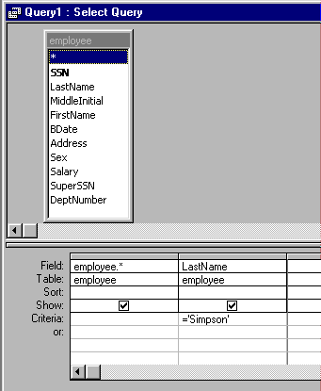
Visual Tools for Query By Example Using Microsoft Access
QBE in MS Access:
Example: One table only with a projection and a selection:
The query is:
Find all the data about all employees whose last name is Simpson.
CS3319

Slide 21
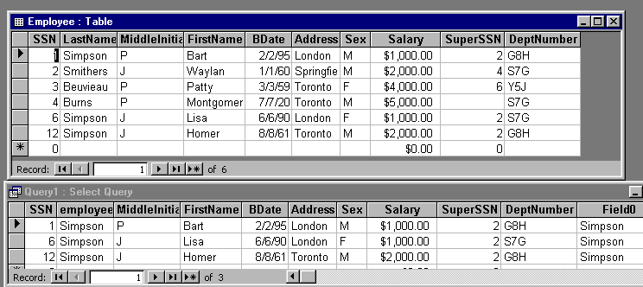

Original Table and the Query Results:
SQL generated by MS Access for QBE above
CS3319

Slide 22
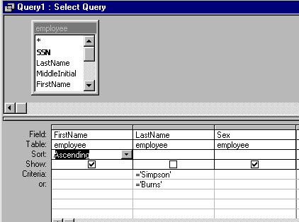
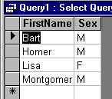
Example: One Table only with a selection, projection, sort and uses an OR
Query:
Results:
QUESTION: Write the above query in SQL:
CS3319

Slide 23
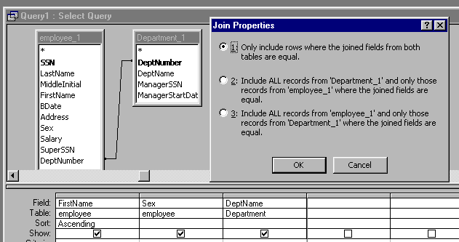
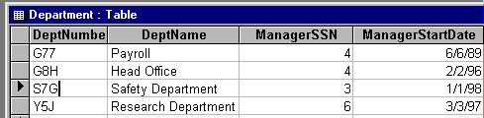
Example: JOINS: Draw a line between the fields that should be joined
Query:
Department Table:
CS3319

Slide 24
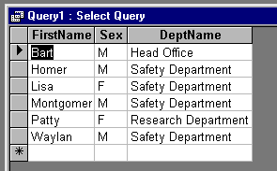

Results of Query:
SQL Generated by the Query:
CS3319

Slide 25
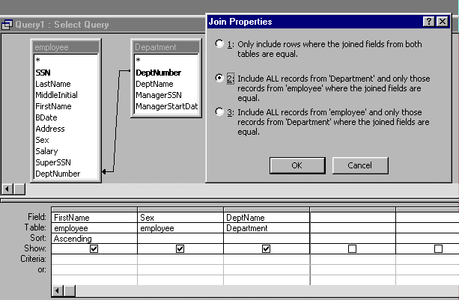
Example: Left Outer Join
Query:
CS3319

Slide 26
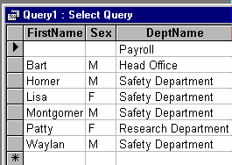

Results from Query:
SQL Generated by the Query:
CS3319

Slide 27
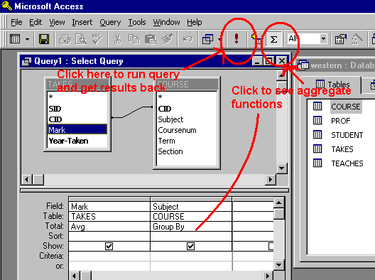
Aggregate Functions:
To do things like totals, averages, maximums, etc…
Query and Tables:
CS3319

Slide 28
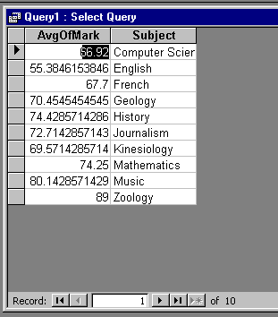

Results from Query:
SQL Generated by the Query:
CS3319

Slide 29
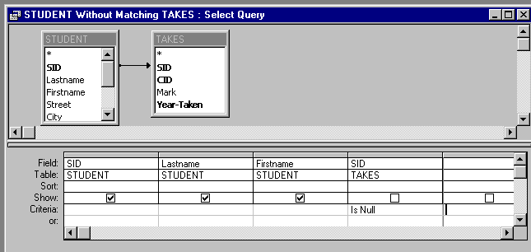
Unmatched Query:
Query: Find the students who don’t take any courses
CS3319

Slide 30
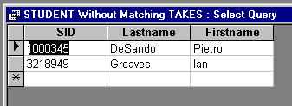
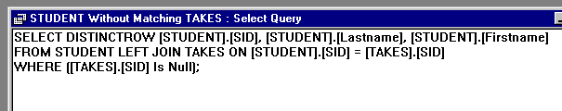
Results from Query:
SQL Generated by the Query:
CS3319

Slide 31
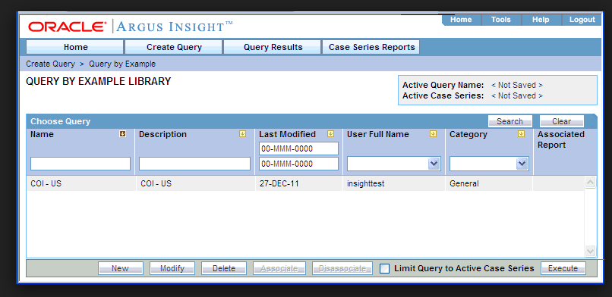
Oracle: Query by Example
CS3319

Slide 32
Review
Relational Calculus shows you what is to be retrieved but not HOW to retrieve it
Query by Example – you don’t have to learn SQL, you can just pick the tables and then fill in columns
CS3319

